Slide 1



Track Tech: Combined GPS and Intensity-based Alignment of Laser Devices
Track Tech: Combined GPS and Intensity-based Alignment of Laser Devices
Track Tech: Combined GPS and Intensity-based Alignment of Laser Devices
Track Tech: Combined GPS and Intensity-based Alignment of Laser Devices
Track Tech: Combined GPS and Intensity-based Alignment of Laser Devices
Dawson Burgess, Spencer Butler, Marissa Samayoa
Notes:
Title, team/project/client info

Slide 2
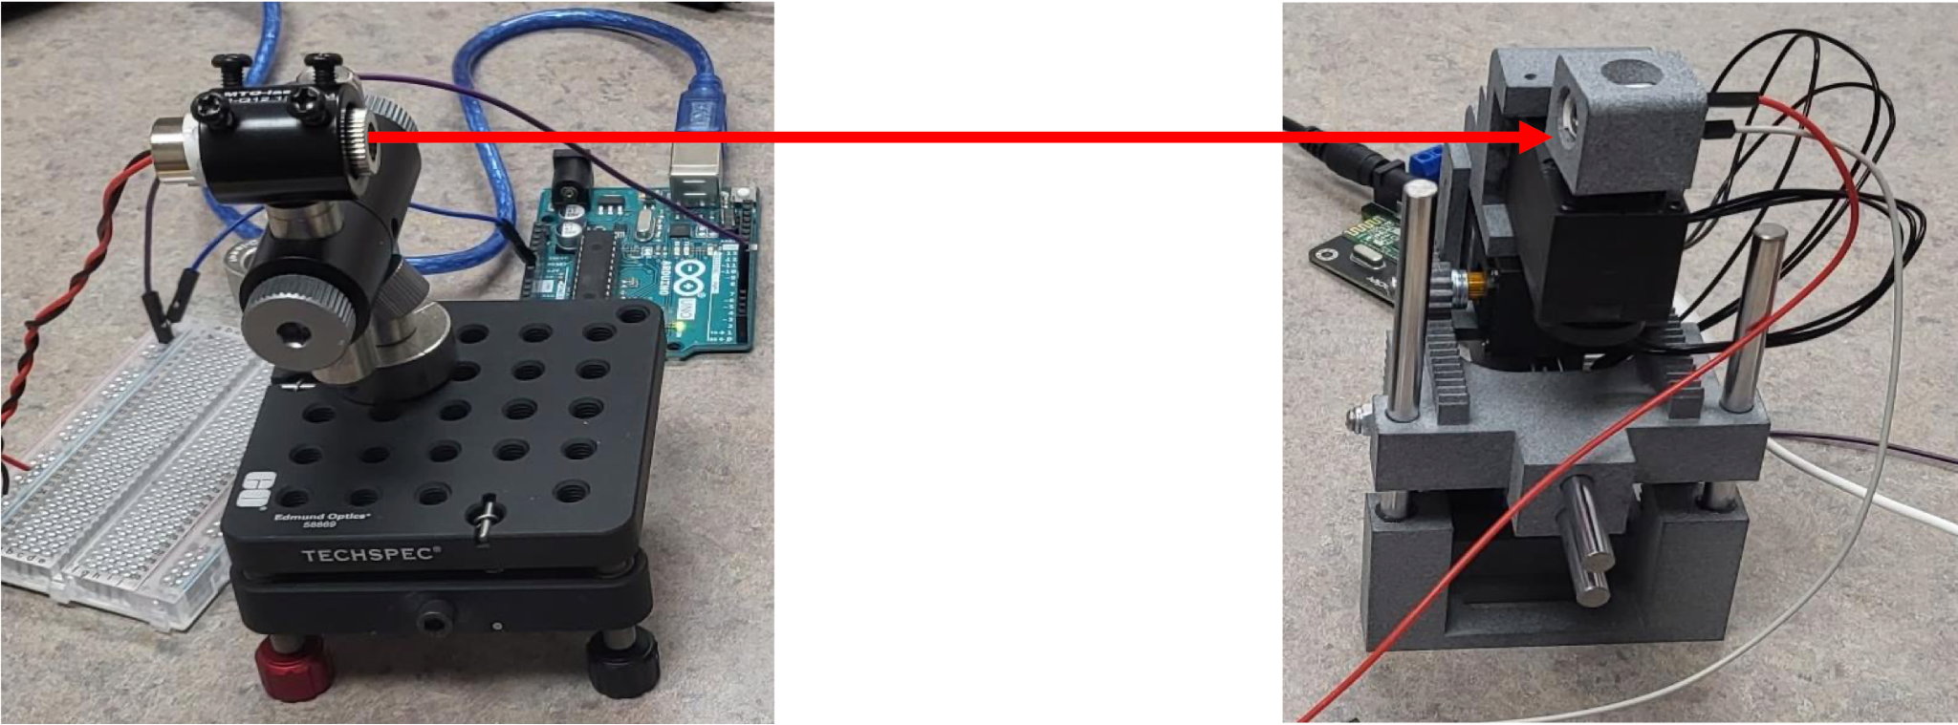
Objective
To implement and test embedded software to drive a robotic arm for optical beam alignment between two devices.
We will be implementing the rough alignment software that will then utilize the minor adjustment software that was created in last year’s capstone.
Notes:
-Dawson

Slide 3

Value Proposition
Optical transfer allows for far greater transfer capacity than using electricity.
It can be implemented in a cost effective, yet environmentally friendly way via lasers.
Laser data transfer requires very precise alignment between two devices, and often takes hours of labor to establish a single connection.
We will design software which utilizes GPS that enables the devices to align and form a connection with a single button press.
Notes:
-Dawson

Slide 4
Product Requirements
01
This alignment process shall work at a minimum distance of 6 feet.
02
After beginning the program, the alignment process shall be fully automatic.
03
The devices shall weigh fewer than 10 lbs each.
04
The program shall be written in a modular style.
Notes:
-Marissa

Slide 5
Conceptual Development
The process our code and design will go through every time it operates:
Acquiring positional data of laser and servo arm
GPS module + accelerometer
Communication Between boards
Wifi vs wired
Code for the alignment process
33
1
2
75%
4
Get positional data
Boards communicate positions
Code for alignment process is executed
Maintain optimal signal strength
Notes:
Spencer

Slide 6
Budget Breakdown
$300 Total
04
04
01 GPS Modules
04 Connectors
Estimated Amount: $100
03
Estimated Amount: $50
01
03
01
02 Accelerometers
03 Possible Arduino Board
02
Estimated Amount: $100
Estimated Amount: $50
Notes:
-Marissa

Slide 7
Project Schedule
Oct
Nov
Dec
Jan
Feb
Mar - May
Developing a plan
Testing of previous work
Development of code
Implementation
Feedback and Adjustments
Project Close
Sourcing documents vital to project:
Project Plan (DVP, Budget, Project Schedule)
Acquiring and testing of previous designs and code.
Starting code design process for our algorithm.
Developing the code necessary to carry out tasks.
Installing all the new parts, getting the code to compile and run properly.
Sharing our work with our client, receiving feedback for final changes.
Finishing out the project with final documents and presentations.
Notes:
-Marissa

